Slide 1

Boston Housing Case : Modeling Methods Under the Data-Adaptive Research Paradigm

Slide 2
Background and Business Decisions
Background
Based on 1970 census data for the Boston area, including 506 town "tracts" (some towns have multiple tracts).
Data utilized to model house prices in relation to community characteristics, as outlined in studies by Harrison and Rubenfeld (1976).
This version incorporates corrections from Gilley and Pace (1996) and Pace and Gilley (1997).
Objective:
Develop a robust multiple linear regression model for Boston housing values using a 10‑fold cross-validation (CV) framework. Our goal is to provide decision-makers with reliable predictions and realistic uncertainty estimates that can inform urban planning, real estate investment, and policy-making.
Managerial Relevance:
Accurate predictions and quantified uncertainty allow managers to identify high-value neighborhoods with confidence and to understand the range of possible outcomes. This, in turn, supports smarter investment and policy decisions.

Slide 3
Plan for Analysis
We will compare three regression approaches:
Multiple Linear Regression (LM)
Gaussian Process Regression (GPR)
Neural Network Regression (NN)
Each model will be trained using 10-fold cross-validation to obtain robust estimates of prediction error and uncertainty.
We will evaluate each method based on actual vs. predicted plots, R², RMSE (plus their standard deviations), variable importance, prediction intervals for both ‘typical’ and ‘high-value’ neighborhoods, and computer execution time.”
Segment 1 focuses on LM using our final traditional model as the starting point. Later segments will cover Gaussian Process Regression and Neural Network Regression.

Slide 4
Recap of the Traditional Model
Final Model from Last Week:
CMEDV= - 51.74+12.90⋅sRM+21.24⋅I(sRM2) - 3.18⋅sAGE - 73.95⋅sDIS - 3.05⋅sTAX - 2.41⋅sPTRATIO
R-squared: 0.8279
Typical Neighborhood:
Confidence Interval: [-71.70, -31.79]
Prediction Interval: [-72.29, -31.20]
High-Value Neighborhood:
Confidence Interval: [-123.44, -42.38]
Prediction Interval: [-123.73, -42.09]
While our traditional analysis had many strengths (a strong R² and reasonable coefficient estimates), the key issue was that the model’s prediction uncertainty was not adequately addressed.
Negative prediction intervals and significant scatter in the fitted line plot suggest that we underreported or underestimated the variability in our forecasts.
This is precisely why adopting the data-adaptive, cross-validation approach is critical it will provide us with more realistic estimates of uncertainty (via RMSESD, R²SD, and better-calibrated prediction intervals) that management can rely on for making informed decisions.
By addressing this issue in the new analysis, we not only improve the robustness of our predictive model but also enhance its practical utility for decision-makers.

Slide 5
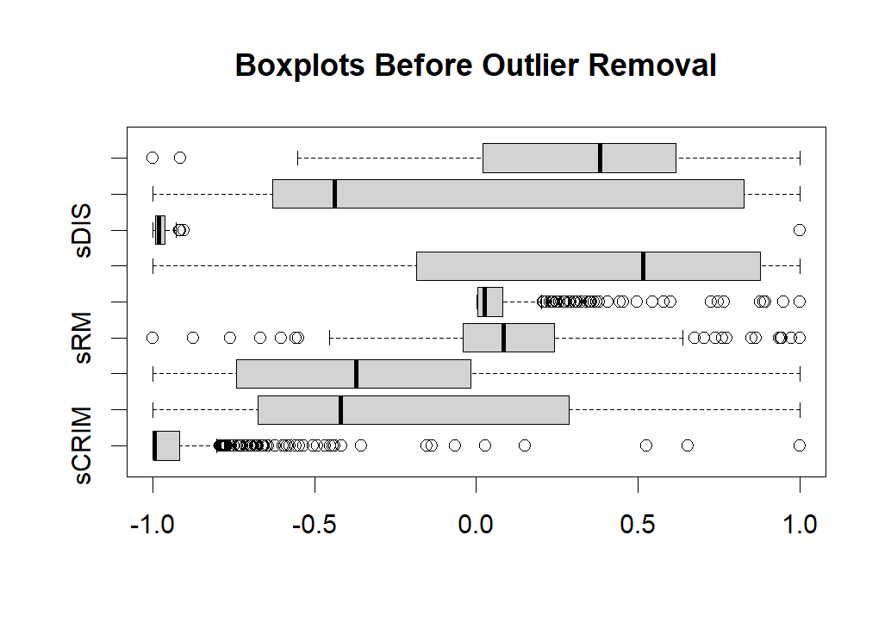
Boxplot Before Outlier Removal
The boxplots show the distribution of several predictor variables (sDIS, sRM, sCRIM) before removing outliers.
The presence of numerous outlier points (marked as circles) in each variable suggests significant skewness and extreme values in the dataset.
sCRIM (scaled crime rate) exhibits a large number of extreme values on the right tail, indicating highly skewed data.
sRM (average number of rooms per dwelling) has some scattered outliers, but the distribution is relatively more centered.
sDIS (weighted distances to employment centers) also shows multiple outliers on both ends of the distribution.
par(mfrow = c(1, 1)) boxplot(boston840s[2:10], horizontal = TRUE, main = "Boxplots Before Outlier Removal")

Slide 6
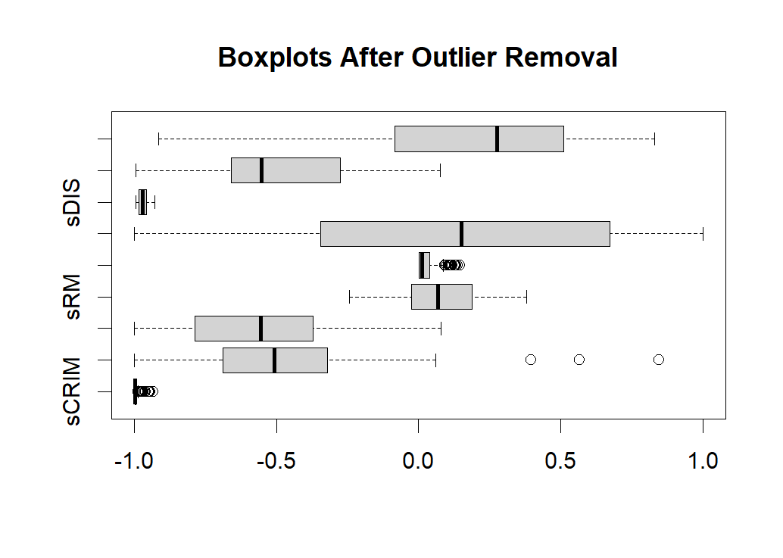
Boxplot After Outlier Removal
After removing outliers using the Interquartile Range (IQR) method, the variability in the dataset has reduced significantly.
The spread of sCRIM is now more concentrated, indicating a better representation of the general trend in the dataset.
The extreme values in sDIS have been mostly eliminated, reducing the impact of distant outliers that may distort regression results.
sRM still shows some remaining outliers, but the overall range of data is more controlled.
remove_outliers <- function(data) { for (col in colnames(data)) { if (col != "CMEDV") { Q1 <- quantile(data[[col]], 0.25, na.rm = TRUE) Q3 <- quantile(data[[col]], 0.75, na.rm = TRUE) IQR_value <- Q3 - Q1 lower_bound <- Q1 - 1.5 * IQR_value upper_bound <- Q3 + 1.5 * IQR_value data <- data[data[[col]] >= lower_bound & data[[col]] <= upper_bound, ] } } return(data)}boston840s <- remove_outliers(boston840s)
par(mfrow = c(1, 1)) boxplot(boston840s[2:10], horizontal = TRUE, main = "Boxplots After Outlier Removal")

Slide 7
Data Summary
Data imported to R as boston840
R code to read the file and summarize it:
library(readxl)
boston840 <-read_excel("boston840.xlsx")
summary(boston840)
The Boston Housing dataset consists of 506 town tracts with predictors such as CRIM, INDUS, NOX, RM, AGE, DIS, TAX, PTRATIO, LSTAT and the response variable CMEDV (corrected median house value).
Variables such as CRIM and DIS exhibit heavy right skew with extreme maximum values, indicating the presence of outliers.
Most variables show a reasonable range with medians and quartiles that help us understand the typical values, while differences between mean and median point to skewness in certain predictors.
Predictors are scaled to the [–1, 1] range, and outliers have been removed using an IQR-based method.
summary(boston840)
CMEDV CRIM INDUS NOX
Min. : 5.00 Min. : 0.00632 Min. : 0.74 Min. :0.3850
1st Qu.:16.50 1st Qu.: 0.07978 1st Qu.: 5.13 1st Qu.:0.4480
Median :20.60 Median : 0.23912 Median : 8.56 Median :0.5380
Mean :21.48 Mean : 3.78357 Mean :11.05 Mean :0.5518
3rd Qu.:24.50 3rd Qu.: 3.69695 3rd Qu.:18.10 3rd Qu.:0.6240
Max. :48.80 Max. :88.97620 Max. :27.74 Max. :0.8710
RM AGE DIS TAX
Min. :3.561 Min. : 2.90 Min. : 1.137 Min. :187.0
1st Qu.:5.879 1st Qu.: 42.40 1st Qu.: 2.111 1st Qu.:284.0
Median :6.185 Median : 76.50 Median : 3.317 Median :334.0
Mean :6.238 Mean : 67.78 Mean : 4.367 Mean :410.9
3rd Qu.:6.565 3rd Qu.: 94.10 3rd Qu.: 5.401 3rd Qu.:666.0
Max. :8.398 Max. :100.00 Max. :228.750 Max. :711.0
PTRATIO LSTAT
Min. :12.60 Min. : 1.98
1st Qu.:17.40 1st Qu.: 7.34
Median :19.10 Median :11.65
Mean :18.58 Mean :12.94
3rd Qu.:20.20 3rd Qu.:17.12
Max. :22.00 Max. :37.97
Variable | Min | 1st Quartile | Median | Mean | 3rd Quartile | Max | Interpretation
CMEDV (House Value) | 5.00 | 16.50 | 20.60 | 21.48 | 24.50 | 48.80 | Wide range, mean close to median.
CRIM (Crime Rate) | 0.00632 | 0.07978 | 0.23912 | 3.78 | 3.69695 | 88.9762 | Right-skewed, extreme high crime in some areas.
RM (Avg. Rooms) | 3.561 | 5.879 | 6.185 | 6.238 | 6.565 | 8.398 | More rooms increase home value.
TAX (Property Tax) | 187.0 | 284.0 | 334.0 | 410.9 | 666.0 | 711.0 | Some very high tax values.

Slide 8
Model Summary: Linear Regression with Cross-Validation
R² = 0.7221
72.79% of the variance in house prices is explained by the model, meaning it has a good predictive ability.
A low residual standard error (2.201) means predictions are generally close to actual values.
The high F-statistic (109.2) and very low p-value confirm that the overall regression model is statistically significant.
Residuals range from -6.55 to 11.66, meaning some predictions have moderate errors.
The median residual is near zero (-0.23), indicating no major bias in predictions.
Some larger residuals (~11.66) suggest possible outliers or nonlinear effects.
Code:
set.seed(123)trainMeth <- trainControl(method = "cv", number = 10)
tic("Linear Regression Model Training Time") CVregModel_lm <- train( CMEDV ~ sRM + SRM2 + sAGE + sDIS + sTAX + sPTRATIO, data = boston840s, method = "lm", trControl = trainMeth)toc()
summary(CVregModel_lm)
Call:
lm(formula = .outcome ~ ., data = dat)
Residuals:
Min 1Q Median 3Q Max
-6.5509 -1.3587 -0.2309 1.2407 11.6630
Coefficients:
Estimate Std. Error t value Pr(>|t|)
(Intercept) -67.9501 10.4024 -6.532 3.72e-10 ***
sRM 10.7164 1.5918 6.732 1.18e-10 ***
SRM2 26.9090 6.4196 4.192 3.87e-05 ***
sAGE -3.2635 0.3218 -10.142 < 2e-16 ***
sDIS -90.5433 10.7200 -8.446 2.68e-15 ***
sTAX -3.3447 0.5756 -5.811 1.92e-08 ***
sPTRATIO -2.7528 0.3596 -7.656 4.43e-13 ***
---
Signif. codes: 0 ‘***’ 0.001 ‘**’ 0.01 ‘*’ 0.05 ‘.’ 0.1 ‘ ’ 1
Residual standard error: 2.201 on 245 degrees of freedom
Multiple R-squared: 0.7279, Adjusted R-squared: 0.7213
F-statistic: 109.2 on 6 and 245 DF, p-value: < 2.2e-16
Linear Regression Model Training Time: 0.45 sec elapsed

Slide 9
Fitting the Model Using 10-Fold CV
252 total samples used for training.
6 predictor variables selected:
sRM (Rooms per Dwelling)
SRM2 (Quadratic Term for Rooms)
sAGE (Older Homes %)
sDIS (Distance to Jobs)
sTAX (Property Tax Rate)
sPTRATIO (Pupil-Teacher Ratio)
No pre-processing applied before training.
Model Resampling Method:
Cross-Validation Type: 10-Fold CV
Sample Sizes Used Per Fold: ~226-228 observations.
print("Model Summary for Linear Regression with Cross-Validation:")
print(CVregModel_lm)
252 samples
6 predictor
No pre-processing
Resampling: Cross-Validated (10 fold)
Summary of sample sizes: 227, 227, 226, 228, 226, 227, ...
Resampling results:
RMSE Rsquared MAE
2.19693 0.7221713 1.660587
Metric | Value | Interpretation
RMSE | 2.1969 | Average prediction error (~$2,197)
R² | 0.7221 | 72.21% of variance in housing prices explained
MAE | 1.660587 | Median absolute prediction error ($1,660)

Slide 10
Cross-Validation Steps & Performance
print("Cross-Validation Steps Summary:")
print(CVregModel_lm$resample)
Variation in RMSE across folds (~1.86 to ~2.94), but mostly within expected range.
Fold 10 had the weakest performance (lowest R² = 0.5307).
Majority of folds show strong R² > 0.7, meaning the model is robust.
RMSE Rsquared MAE Resample
1 2.063094 0.7551660 1.625182 Fold01
2 1.950335 0.7557187 1.711373 Fold02
3 2.442941 0.7114775 1.871158 Fold03
4 1.861751 0.8200391 1.279992 Fold04
5 2.800269 0.6120354 1.563895 Fold05
6 1.868237 0.8250844 1.616616 Fold06
7 2.225917 0.6778886 1.734234 Fold07
8 2.022827 0.7111681 1.512303 Fold08
9 1.798816 0.8224167 1.419428 Fold09
10 2.935114 0.5307181 2.271685 Fold10
Fold | RMSE | R² | MAE
Fold 1 | 2.0631 | 0.7552 | 1.6252
Fold 2 | 1.9503 | 0.7557 | 1.7114
Fold 3 | 2.4429 | 0.7115 | 1.8712
Fold 4 | 1.8618 | 0.8200 | 1.2800
Fold 5 | 2.8003 | 0.6120 | 1.5639
Fold 6 | 1.8682 | 0.8251 | 1.6166
Fold 7 | 2.2259 | 0.6779 | 1.7342
Fold 8 | 2.0228 | 0.7112 | 1.5123
Fold 9 | 1.7988 | 0.8224 | 1.4194
Fold 10 | 2.9351 | 0.5307 | 2.2717

Slide 11
Model Coefficients & Interpretation
print(CVregModel_lm$finalModel$coefficients)
(Intercept) sRM SRM2 sAGE sDIS sTAX
-67.950058 10.716380 26.909005 -3.263457 -90.543276 -3.344699
sPTRATIO
-2.752815
CMEDV=−67.95+10.71⋅sRM+26.90⋅SRM 2 −3.26⋅sAGE−90.54⋅sDIS−3.34⋅sTAX−2.75⋅sPTRATIO
sRM and SRM2 confirm that more rooms increase home values significantly.
Distance to jobs (sDIS) has the strongest negative impact.
Older homes (sAGE) and high property taxes (sTAX) reduce house values.

Slide 12
Model Uncertainty
Low standard deviation in RMSE (0.40) indicates model is stable.
Some variation in R² indicates model performs slightly differently across datasets.
print(c("RMSE", CVregModel_lm$results$RMSE))
print(c("Standard Deviation of RMSE", CVregModel_lm$results$RMSESD))
print(c("R-squared", CVregModel_lm$results$Rsquared))
print(c("Standard Deviation of R-squared", CVregModel_lm$results$RsquaredSD))
print(c("RMSE", CVregModel_lm$results$RMSE))
[1] "RMSE" "2.19693016515154"
> print(c("Standard Deviation of RMSE", CVregModel_lm$results$RMSESD))
[1] "Standard Deviation of RMSE" "0.402520975232974"
> print(c("R-squared", CVregModel_lm$results$Rsquared))
[1] "R-squared" "0.722171281400654"
> print(c("Standard Deviation of R-squared", CVregModel_lm$results$RsquaredSD))
[1] "Standard Deviation of R-squared" "0.0962710669889897"
Metric | Mean | Standard Deviation
RMSE | 2.1969 | 0.4025
R² | 0.7221 | 0.0963

Slide 13
Prediction Intervals
predictVals <- predict(CVregModel_lm, newdata = boston840s)
pUpper <- predictVals + 2 * CVregModel_lm$results$RMSE
pLower <- predictVals - 2 * CVregModel_lm$results$RMSE
print("Approximate Prediction Intervals:")
print(cbind(Predicted = predictVals, Lower = pLower, Upper = pUpper))
Each row in the table consists of three values:
The model predicts that the house value is $20,495
However, there is uncertainty in the prediction, so the actual price could range between $16,101 and $24,889
We are 95% confident that the true price falls within this range
Predicted Lower Upper
2 20.49552 16.10166 24.88938
4 24.23747 19.84361 28.63133
6 22.12137 17.72751 26.51523
7 22.32249 17.92863 26.71635
8 20.45996 16.06610 24.85382
13 23.36428 18.97042 27.75814
14 20.33608 15.94222 24.72994
15 20.50604 16.11218 24.89990
16 25.39215 20.99829 29.78601
22 23.56036 19.16650 27.95422
24 27.30742 22.91356 31.70128
25 21.24855 16.85469 25.64241
26 22.65748 18.26362 27.05134
27 24.98548 20.59161 29.37934
29 19.04053 14.64667 23.43439
31 17.00777 12.61391 21.40163

Slide 14
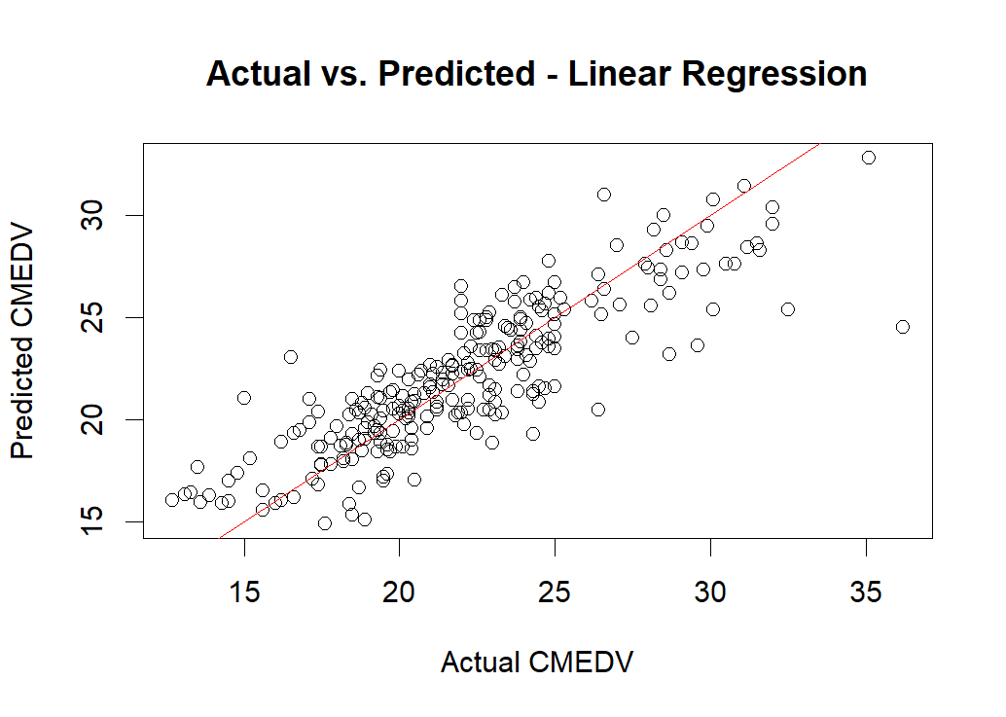
Actual vs. Predicted Plot
Most points align closely with this line, suggesting a strong correlation between actual and predicted values.
However, some points deviate significantly, indicating potential prediction errors.
Model Performance Metrics:
R² = 0.7221
Model explains 72.21% of the variance in house prices.
RMSE = 2.1969
The average prediction error is $2,197.
The model captures the overall trend well.
Some variation remains unexplained, which may indicate non-linearity or missing predictors.
par(mfrow = c(1, 1))
plot(boston840s$CMEDV, predicted_lm,xlab = "Actual CMEDV", ylab = "Predicted CMEDV", main = "Actual vs. Predicted - Linear Regression",col = "black")
abline(0, 1, col = "red")

Slide 15
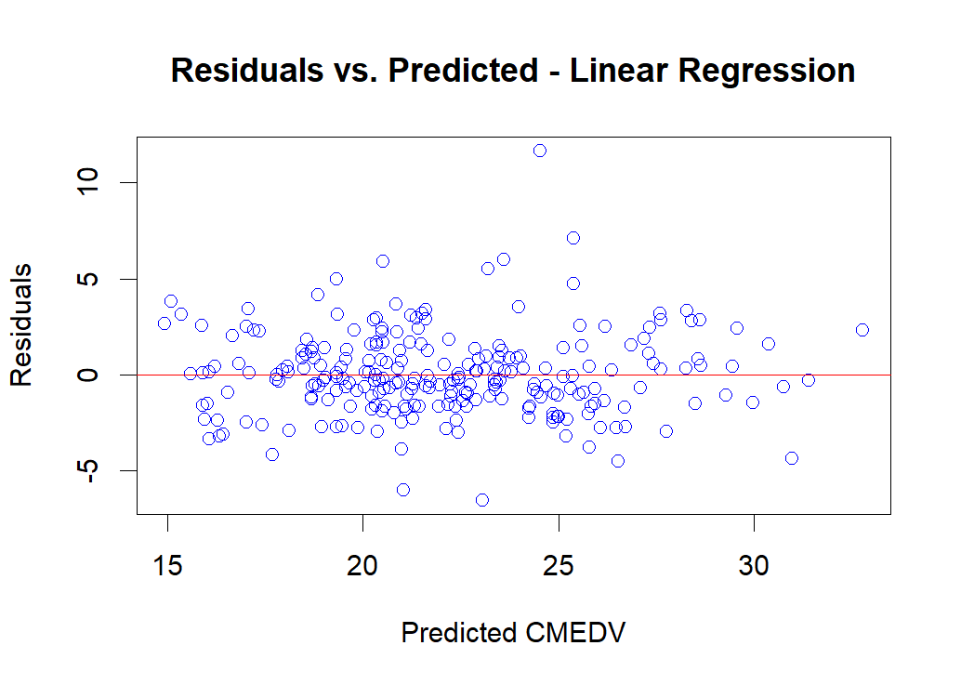
Residuals vs. Predicted Plot
Residuals should be randomly scattered around the horizontal line (y = 0).
In this plot, the residuals are mostly centered around zero, indicating that the model captures the trend well.
However, some points deviate significantly, suggesting potential heteroscedasticity (uneven spread of residuals).
No strong pattern in residuals indicates good model fit
Slight funnel shape (wider spread at high values) indicates possible heteroscedasticity
A few large residuals indicates the model may struggle with outliers or extreme values.
par(mfrow = c(1, 1))
plot(predicted_lm, resid_lm,xlab = "Predicted CMEDV", ylab = "Residuals",main = "Residuals vs. Predicted - Linear Regression",col = "blue")
abline(h = 0, col = "red")

Slide 16
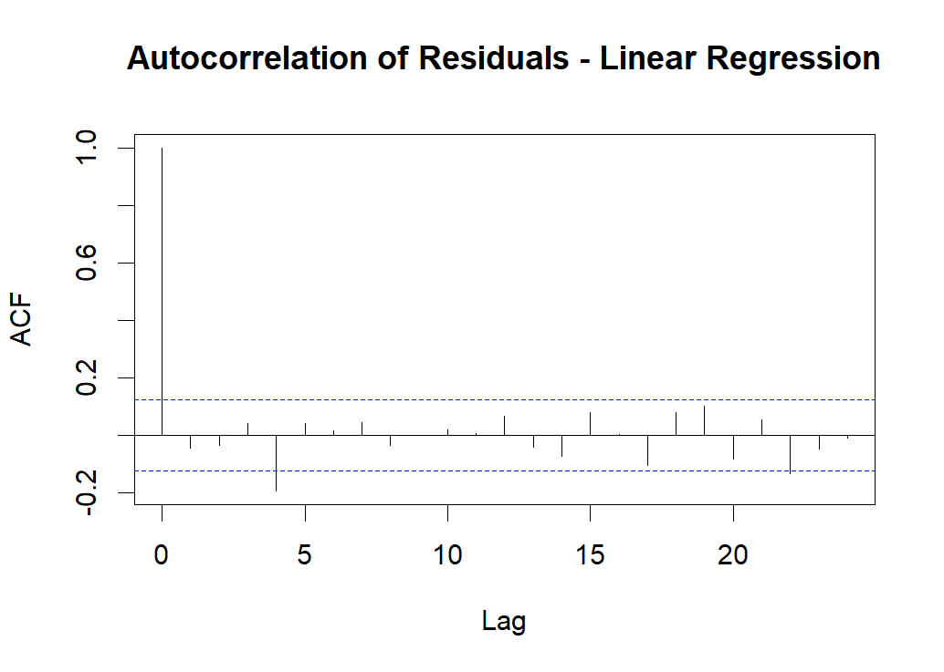
Autocorrelation of Residuals (ACF Plot)
The plot shows the autocorrelation values for different lags.
The first lag is 1, which is expected because residuals are always correlated with themselves.
The remaining lags fall mostly within the blue confidence bands, indicating no significant autocorrelation in residuals.
This suggests that the residuals are independent, which is a good sign for model validity.
The linear regression model does not suffer from serious autocorrelation issues, meaning the residuals are randomly distributed over time.
par(mfrow = c(1, 1)) acf(resid_lm, main = "Autocorrelation of Residuals - Linear Regression")

Slide 17
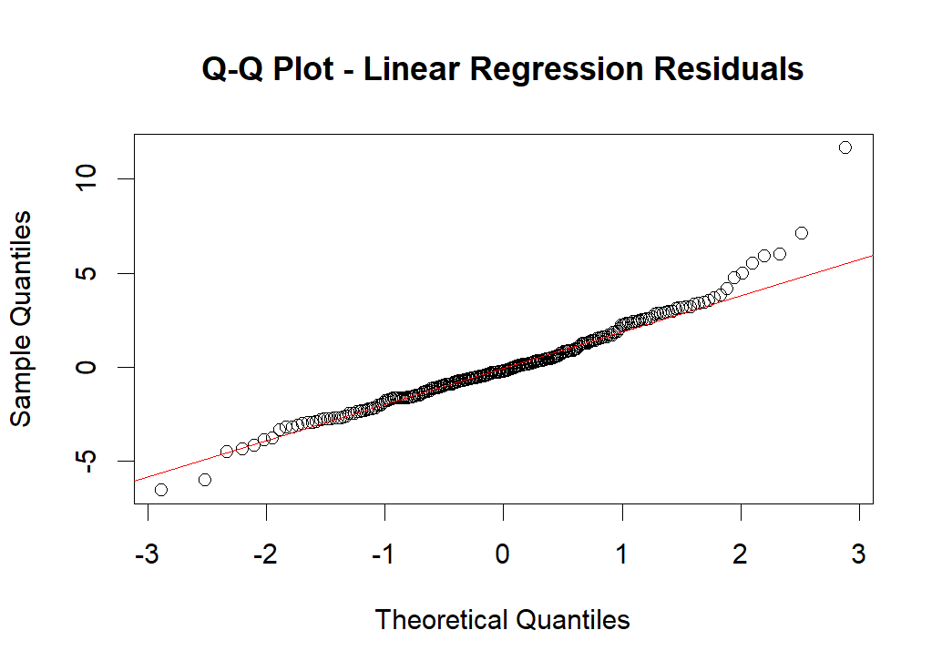
Q-Q Plot of Residuals
Most of the points are close to the red diagonal line, indicating that residuals are approximately normal.
However, there are slight deviations in the tails, especially on the right, suggesting some extreme residual values.
This might indicate some skewness or the presence of outliers.
The residuals are approximately normal but may have some heavy tails or outliers. This is something to consider when interpreting the model’s predictions.
par(mfrow = c(1, 1)) qqnorm(resid_lm, main = "Q-Q Plot - Linear Regression Residuals")qqline(resid_lm, col = "red")

Slide 18
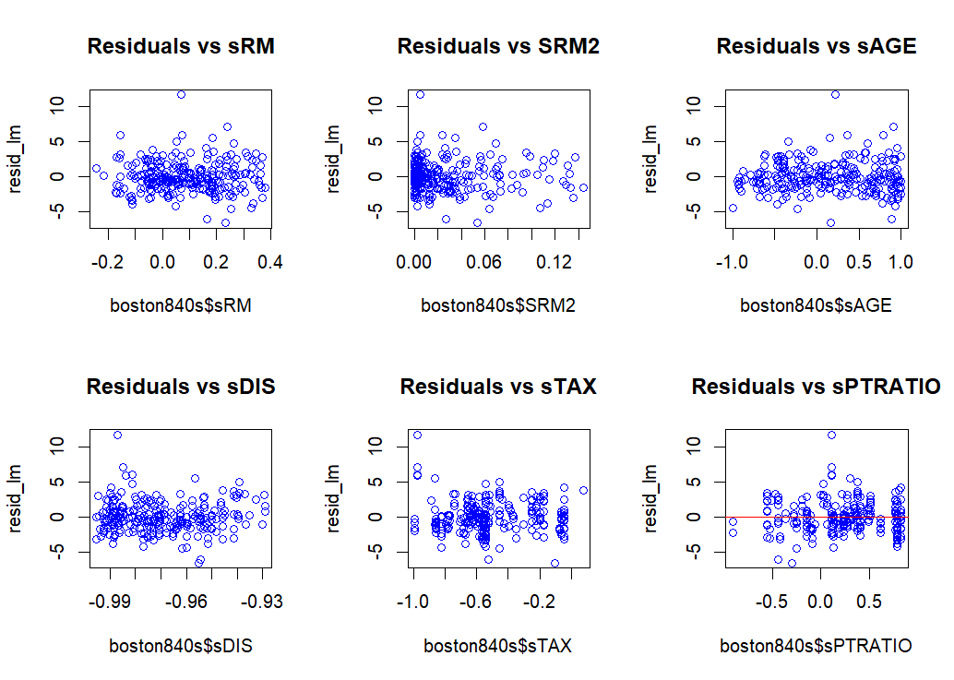
Residuals vs. Predictors (Six Residual Plots)
1.Residuals vs. sRM: Residuals are fairly spread out with no strong pattern, suggesting a reasonable linear relationship.
2.Residuals vs. SRM²: Some clustering is visible, suggesting that higher-order terms may be needed.
3.Residuals vs. sAGE:Residuals seem somewhat spread but show some slight non-random clustering, hinting that the model might not fully capture its effect.
4.Residuals vs. sDIS: Residuals seem scattered with no clear trend, which is a good sign.
5.Residuals vs. sTAX: No strong pattern, confirming a good fit for this variable.
6.Residuals vs. sPTRATIO: Slight clustering is observed, which could indicate a nonlinear relationship or interactions not captured in the model.
par(mfrow = c(2, 3))
plot(boston840s$sRM, resid_lm, main = "Residuals vs sRM", col = "blue")plot(boston840s$SRM2, resid_lm, main = "Residuals vs SRM2", col = "blue")
plot(boston840s$sAGE, resid_lm, main = "Residuals vs sAGE", col = "blue")
plot(boston840s$sDIS, resid_lm, main = "Residuals vs sDIS", col = "blue")
plot(boston840s$sTAX, resid_lm, main = "Residuals vs sTAX", col = "blue")
plot(boston840s$sPTRATIO, resid_lm, main = "Residuals vs sPTRATIO", col = "blue")abline(h = 0, col = "red")

Slide 19
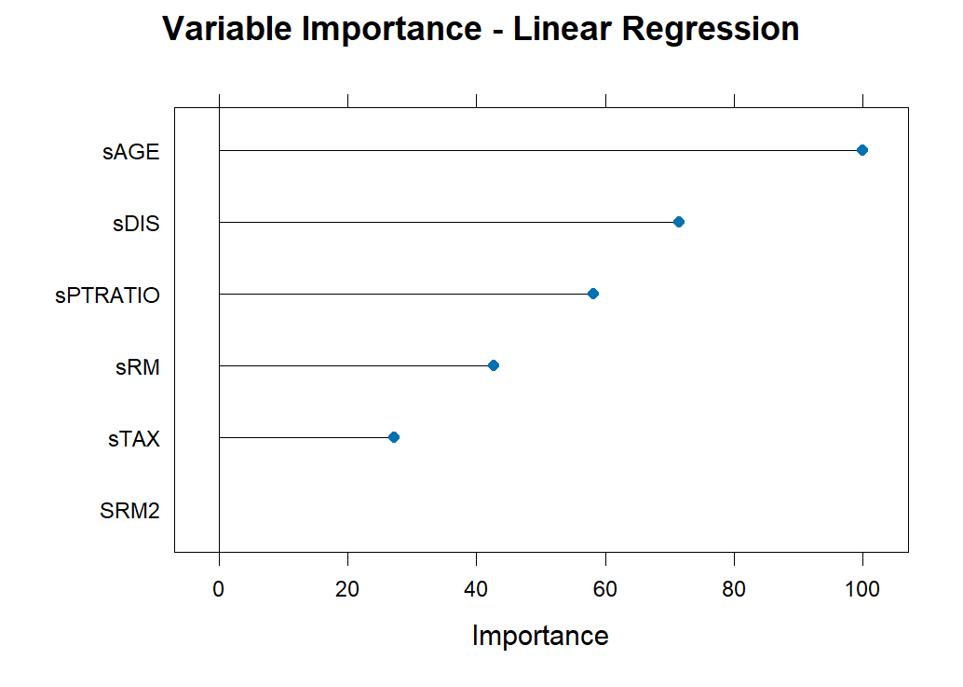
Variable Importance Plot for Linear Regression
The most critical variables affecting home prices are sAGE, sDIS, and sPTRATIO.
Factors such as the number of rooms (sRM) and tax rates (sTAX) also play a role but with lesser impact.
This plot helps decision-makers focus on the most influential factors for pricing, investment, and policy-making in the housing market.
plot(varImp(CVregModel_lm), main = "Variable Importance - Linear Regression")

Slide 20
Gaussian Process Regression (GP) Model
Code:
tic("Gaussian Process Regression Model Training Time")
CVregModel_gp <- train( CMEDV ~ sRM + SRM2 + sAGE + sDIS + sTAX + sPTRATIO, data = boston840s, method = "gaussprRadial",
# Gaussian Process with radial (exponential) kernel trControl = trainMeth, preProc = c("center", "scale")
# Optional pre-processing)
toc()
print("Model Summary for Gaussian Process Regression (gaussprRadial):")
print(CVregModel_gp)
Output:
Gaussian Process Regression Model Training Time: 4.56 sec elapsed
>
> print("Model Summary for Gaussian Process Regression (gaussprRadial):")
[1] "Model Summary for Gaussian Process Regression (gaussprRadial):"
> print(CVregModel_gp)
Gaussian Process with Radial Basis Function Kernel
252 samples
6 predictor
Pre-processing: centered (6), scaled (6)
Resampling: Cross-Validated (10 fold)
Summary of sample sizes: 228, 228, 226, 226, 227, 228, ...
Resampling results:
RMSE Rsquared MAE
2.235873 0.7315416 1.655124
The sample sizes vary slightly (226-228), likely due to rounding when splitting data.
Here, an RMSE of 2.23 means that, on average, the model's predictions deviate by around 2.23 units of CMEDV (house price).Since house prices are in thousands, this means an error of ~$2,230
R² = 0.73 means that 73% of the variance in house prices is explained by the model. This is a strong result for a real-world dataset, but it also suggests room for improvement
MAE of 1.65 means the model's predictions are off by an average of $1,650.
Tuning parameter 'sigma' was held constant at a value of 0.2050497
Gaussian Process Regression Model Training Time: 0.90 sec elapsed

Slide 21
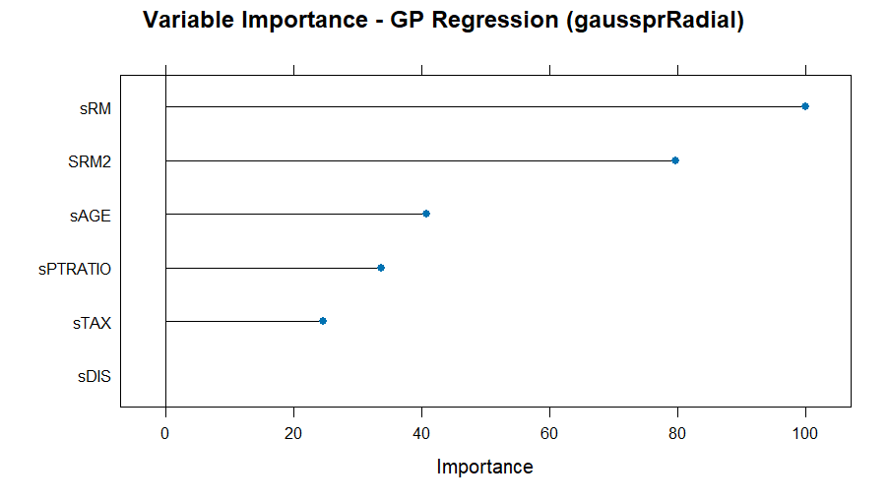
Variable Importance Plot for GP Model
sRM (Scaled Average Number of Rooms) has the highest importance, indicating that more (or fewer) rooms in a house strongly affects predicted prices.
SRM2 (Squared sRM) is next, showing that the effect of having additional rooms is nonlinear it doesn’t simply add a fixed amount to the house price for every room.
sAGE (Scaled Age) is moderately important. Older houses may be valued differently compared to newer ones.
sPTRATIO and sTAX are somewhat less important but still affect price predictions (buyers may consider local taxes and school quality).
sDIS (Scaled Distance to Employment Centers) is least important for this dataset, suggesting the model finds commute distance less critical than other factors.
The number and quality of rooms (reflected by sRM and SRM2) are most critical for predicting house prices in this model.
Older homes, tax rates, and schools have real (but smaller) impacts.
Distance to job centers is not a strong driver of house price variability in this dataset.
Code:
plot(varImp(CVregModel_gp), main = "Variable Importance - GP Regression (gaussprRadial)")

Slide 22
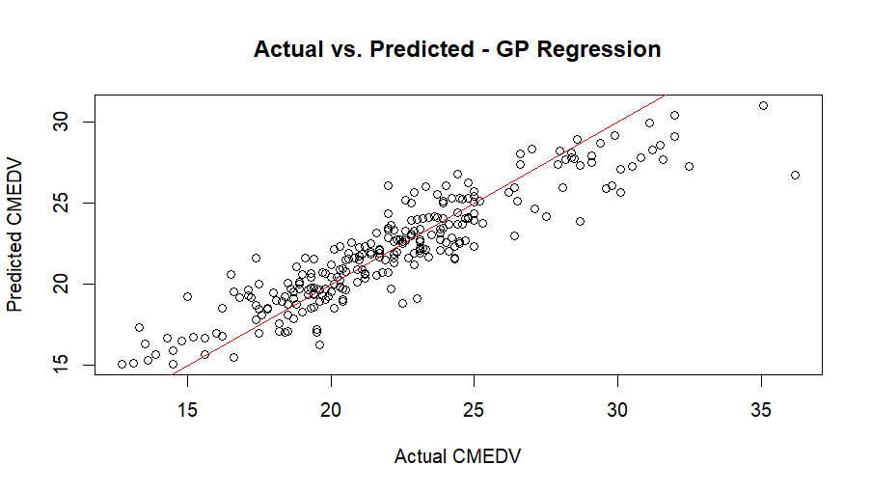
Practical Predictive Ability
There is a positive trend: as the actual values (CMEDV) increase, the predicted values also increase.
This shows the model is capturing the overall relationship between predictors and home value.
Some underestimation (points above the line) can be seen at high price neighborhoods (around 30 or 35 on the x-axis).
Some overestimation (points below the line) appears in a cluster around 15–17 on the x-axis.
These outliers suggest that for very high or very low house prices, the model might not be as precise.
[1] "GP Model RMSE: 2.23587334113284"
[1] "GP Model R-squared: 0.731541567678382"
predicted_gp <- predict(CVregModel_gp, newdata = boston840s)
resid_gp <- boston840s$CMEDV - predicted_gp
# Fitted line plot: Actual vs. Predicted for GP model
par(mfrow = c(1, 1))
plot(boston840s$CMEDV, predicted_gp,
xlab = "Actual CMEDV",
ylab = "Predicted CMEDV",
main = "Actual vs. Predicted - GP Regression",
col = "black")
abline(0, 1, col = "red") # 45-degree reference line
# Extract and print RMSE and R-squared for GP model
gp_RMSE <- CVregModel_gp$results$RMSE
gp_Rsquared <- CVregModel_gp$results$Rsquared
print(paste("GP Model RMSE:", gp_RMSE))
print(paste("GP Model R-squared:", gp_Rsquared))

Slide 23
Prediction Uncertainty
RMSESD = 0.47 is relatively low, suggesting that the model has consistent error rates across folds.
This indicates the model is reliable and is not overly sensitive to the data split.
R-squaredSD = 0.07589, which is low. This means that the model’s explanatory power remains consistent across different training/testing folds.
The R² values across CV runs do not vary significantly, suggesting that the model generalizes well.
Code:
gp_RMSESD <- CVregModel_gp$results$RMSESD
gp_RsquaredSD <- CVregModel_gp$results$RsquaredSD
print("GP Model Uncertainty Assessment:")
print(c("RMSESD", gp_RMSESD))
print(c("R-squaredSD", gp_RsquaredSD))
Output:
[1] "GP Model Uncertainty Assessment:"
[1] "RMSESD" "0.47096231954768"
[1] "R-squaredSD" "0.0758966240690277"

Slide 24
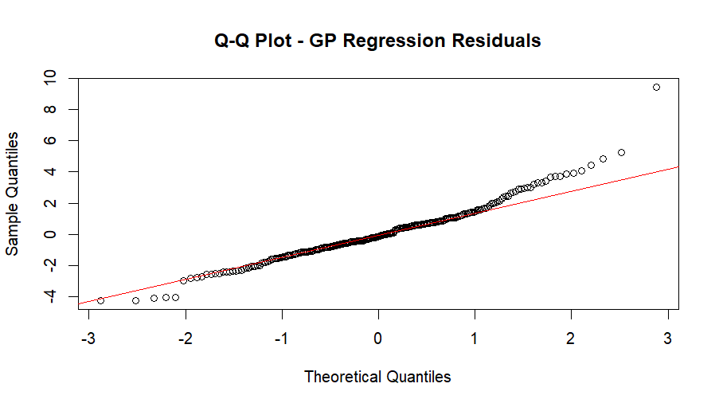
Model Quality Check for GP Model
Most of the residuals are normally distributed, but some extreme values deviate from normality.
The residuals mostly follow the red line, indicating the model captures the distribution of errors well.
There is no major skewness in the residuals, meaning the model does not systematically overestimate or underestimate prices.
The right tail (higher house prices) has more extreme values, meaning some expensive houses are underpredicted.
The left tail (lower house prices) has slight deviations, indicating a few overpredicted low-value houses.
This suggests that while the GP model works well overall, it struggles with extreme price values.
Code:
Autocorrelation of residuals
par(mfrow = c(1, 1))
acf(resid_gp, main = "Autocorrelation of Residuals - GP Regression")#
#Normality check using Q-Q Plot
par(mfrow = c(1, 1))
qqnorm(resid_gp, main = "Q-Q Plot - GP Regression Residuals")
qqline(resid_gp, col = "red")

Slide 25
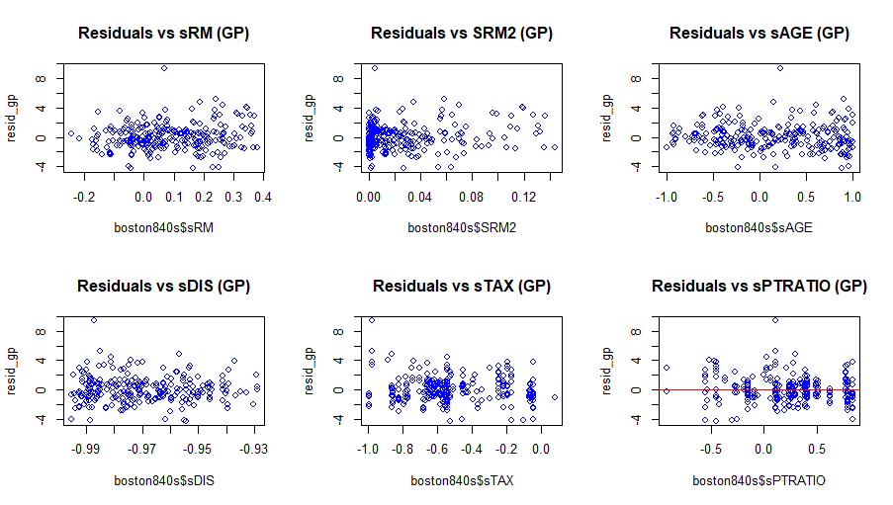
Model Quality Checks for GP Model
1. Residuals vs. sRM (GP)
The points show roughly random scatter around zero, implying that once we account for sRM in the model, there is no clear leftover pattern in the errors.
2. Residuals vs. SRM2 (GP)
Most points again cluster around zero, with no obvious trend.
This suggests the quadratic effect of rooms has been handled appropriately by the GP model.
3. Residuals vs. sAGE (GP)
The residuals do not display a strong pattern across different ages.
A random cloud around zero indicates that the effect of housing age has mostly been accounted for in the predictions.
4. Residuals vs. sDIS (GP)
No strong trend or clustering pattern is evident, suggesting the model captures whatever effect distance might have.
5. Residuals vs. sTAX (GP)
Points form a random scatter with no major trend.The model handles property tax differences reasonably well, without leaving structured residuals.
6. Residuals vs. sPTRATIO (GP)
Points hover around zero, with no strong slope or pattern across different sPTRATIO values.
This indicates the GP model does not systematically over- or under-predict at any particular student-teacher ratio range.
par(mfrow = c(2, 3))
plot(boston840s$sRM, resid_gp, main = "Residuals vs sRM (GP)", col = "blue")
plot(boston840s$SRM2, resid_gp, main = "Residuals vs SRM2 (GP)", col = "blue")
plot(boston840s$sAGE, resid_gp, main = "Residuals vs sAGE (GP)", col = "blue")
plot(boston840s$sDIS, resid_gp, main = "Residuals vs sDIS (GP)", col = "blue")
plot(boston840s$sTAX, resid_gp, main = "Residuals vs sTAX (GP)", col = "blue")
plot(boston840s$sPTRATIO, resid_gp, main = "Residuals vs sPTRATIO (GP)", col = "blue")
abline(h = 0, col = "red")

Slide 26
Compute Prediction Values AND CV-Based Prediction Intervals
1. Typical Neighborhood Prediction
The model estimates that the median house value (CMEDV) for a typical neighborhood is ~$21.38k
Lower / Upper (~95% Interval): 16.90631 / 25.8498
Using ±2 × RMSE as an approximate measure of uncertainty, the model suggests that the true median house value for this typical neighborhood could reasonably fall between $16.91k and $25.85k.
A typical Boston neighborhood, as defined here, is expected to have a home value around $21k, with a fair margin of error (±4.47) based on the model’s cross-validation performance.
2. High-Value Neighborhood Prediction
For the single neighborhood with the highest actual CMEDV in the dataset, the model predicts a value of about $26.75k
Lower / Upper (~95% Interval): 22.27483 / 31.21832
The uncertainty range here is approximately $22.27k to $31.22k.
This result indicates the model expects the highest-priced neighborhood to have a median house value around $26.75k—with a broader interval reflecting that expensive neighborhoods often have more variation and are harder to predict precisely.
typical <- data.frame( sRM = median(boston840s$sRM, na.rm = TRUE), SRM2 = median(boston840s$SRM2, na.rm = TRUE), sAGE = median(boston840s$sAGE, na.rm = TRUE), sDIS = median(boston840s$sDIS, na.rm = TRUE), sTAX = median(boston840s$sTAX, na.rm = TRUE), sPTRATIO = median(boston840s$sPTRATIO, na.rm = TRUE))
# Define a "high value" neighborhood as the one with the highest CMEDVhigh_value <- boston840s[which.max(boston840s$CMEDV), c("sRM", "SRM2", "sAGE", "sDIS", "sTAX", "sPTRATIO")]
# Prediction and approximate CV-based prediction intervals (using ±2*RMSE) for typical neighborhoodpred_typical <- predict(CVregModel_gp, newdata = typical)CI_typical_upper <- pred_typical + 2 * gp_RMSECI_typical_lower <- pred_typical - 2 * gp_RMSE
# Prediction and intervals for high value neighborhoodpred_high <- predict(CVregModel_gp, newdata = high_value)CI_high_upper <- pred_high + 2 * gp_RMSECI_high_lower <- pred_high - 2 * gp_RMSEprint("Prediction for Typical Neighborhood (GP Regression):")
print(data.frame(Predicted = pred_typical, Lower = CI_typical_lower, Upper = CI_typical_upper))print("Prediction for High Value Neighborhood (GP Regression):")
print(data.frame(Predicted = pred_high, Lower = CI_high_lower, Upper = CI_high_upper))
Prediction for Typical Neighborhood (GP Regression):
Predicted Lower Upper
1 21.37805 16.90631 25.8498
Prediction for High Value Neighborhood (GP Regression):
Predicted Lower Upper
1 26.74658 22.27483 31.21832

Slide 27
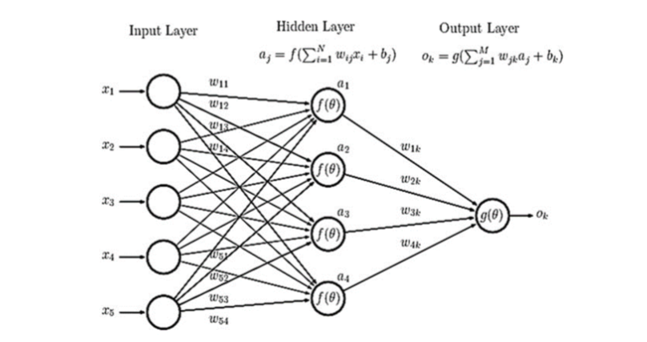
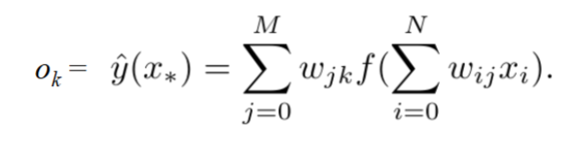
Introduction to Neural Network Models
Neural networks are a type of machine learning model inspired by the human brain. Just like our brains have neurons that process information, a neural network has artificial neurons (also called nodes) that work together to make predictions.
How Does a Neural Network Work?
Input Layer:
- This is where the model receives data (e.g., the number of rooms, tax rates, or house age in our housing dataset).
- Each input is like a piece of information the model uses to make decisions.
Hidden Layers:
- These layers process the input data.
- Each neuron in a hidden layer takes in numbers, applies math, and passes the result to the next layer.
- More hidden layers mean the network can learn more complex patterns.
Output Layer:
- This gives the final prediction (e.g., predicted house price).
FORMULA

Slide 28
Nnet regression model
set.seed(123)
tic("Neural Network Regression Model Training Time")
CVregModel_nnet <- train(
CMEDV ~ sRM + SRM2 + sAGE + sDIS + sTAX + sPTRATIO,
data = boston840s,
method = "nnet",
trControl = trainMeth,
linout = TRUE,
trace = FALSE,
tuneGrid = expand.grid(
size = c(5, 9, 9),
decay = c(0, 0.01, 0.1)
)
)
toc()
print("Model Summary for Neural Network Regression (nnet):")
print(CVregModel_nnet)
The neural network was tested with different settings to find the best one.
Size (Hidden Layer Size): Number of neurons in the hidden layer.
5 neurons (tested for decay 0.00, 0.01, 0.10)
9 neurons (tested for decay 0.00, 0.01, 0.10)
Decay (Regularization): A parameter that helps prevent overfitting. Higher decay means stronger regularization
Performance Metrics for Each Combination:
RMSE (Root Mean Squared Error) : Lower is better (indicates smaller prediction errors).
R² (R-squared) : Higher is better (measures how well the model explains house prices).
MAE (Mean Absolute Error) : Measures average absolute prediction error (lower is better).
The best model was chosen based on the lowest RMSE.
The winning model:
Size = 5 (5 neurons in the hidden layer)
Decay = 0.1 (moderate regularization)
RMSE = 2.1034 : Smallest among all tested models.
R² = 0.7486 : Highest R², meaning it explains ~75% of the variance in house prices.
Neural Network
252 samples
6 predictor
No pre-processing
Resampling: Cross-Validated (10 fold)
Summary of sample sizes: 227, 227, 226, 228, 226, 227, ...
Resampling results across tuning parameters:
size decay RMSE Rsquared MAE
5 0.00 2.275621 0.7000278 1.708210
5 0.01 2.309400 0.7141313 1.678868
5 0.10 2.103400 0.7486331 1.593080
9 0.00 2.677830 0.6835476 1.818371
9 0.01 2.213408 0.7263873 1.691103
9 0.10 2.143317 0.7369610 1.610346
RMSE was used to select the optimal model using the smallest value.
The final values used for the model were size = 5 and decay = 0.1.
Neural Network Regression Model Training Time: 5.78 sec elapsed

Slide 29
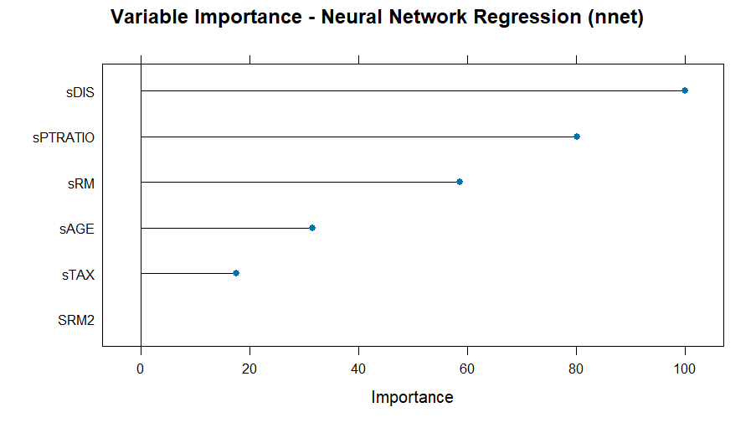
varImp plot and Interpretation
Key Observations from the Graph
sDIS
- This variable has the highest importance score (~100), meaning it plays the biggest role in predicting house prices.
- This makes sense because houses closer to employment centers tend to be more expensive due to convenience.
sPTRATIO
- The second most important variable, showing that better school quality is associated with higher house prices.
sRM
- This is a key predictor of house prices, as more rooms usually indicate larger, more expensive houses.
sAGE
- Older homes may be less desirable, impacting property values, but they don’t have as much influence as the top three variables.
sTAX
- Property tax does affect house prices, but in this case, it has less influence compared to other factors.
SRM2
- This squared term was included to capture non-linear effects but has minimal importance in this model.
plot(varImp(CVregModel_nnet), main = "Variable Importance - Neural Network Regression (nnet)")

Slide 30
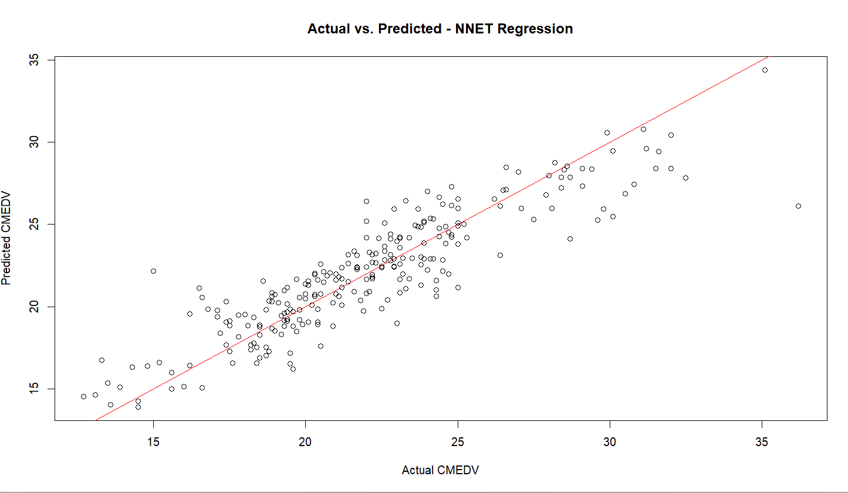
Practical Predictive Ability
The best-performing model has the lowest RMSE (2.1034).
This means that on average, the predicted house price is off by about $2,103.
The best-performing model has the highest R² (0.7486).
This means that about 74.86% of the variation in house prices is explained by the model.
Most of the points follow the red line, meaning the model is making fairly accurate predictions.
The trend indicates that as actual house prices increase, the model's predictions also increase, which is expected.
The model underestimates some expensive homes (dots below the line in the upper right).
The model overestimates some cheaper homes (dots above the line in the lower left).
This suggests that the neural network struggles slightly at extreme values (very high or very low house prices).
[1]"NNET Model RMSE: 2.2756212166756"
"NNET Model RMSE: 2.30940014171964"
[3] "NNET Model RMSE: 2.1033995420506"
"NNET Model RMSE: 2.67782975378241"
[5] "NNET Model RMSE: 2.21340766994438"
"NNET Model RMSE: 2.143317096375"
[1]"NNET Model R-squared: 0.700027755958679"
"NNET Model R-squared: 0.714131257135201"
[3] "NNET Model R-squared: 0.748633131082193"
"NNET Model R-squared: 0.683547626648014"
[5] "NNET Model R-squared: 0.726387328068246"
"NNET Model R-squared: 0.736960970656784"
predicted_nnet <- predict(CVregModel_nnet, newdata = boston840s)
resid_nnet <- boston840s$CMEDV - predicted_nnet
# Fitted line plot: Actual vs. Predicted for NNET model
par(mfrow = c(1, 1))
plot(boston840s$CMEDV, predicted_nnet,
xlab = "Actual CMEDV",
ylab = "Predicted CMEDV",
main = "Actual vs. Predicted - NNET Regression",
col = "black")
abline(0, 1, col = "red")
# Extract and print RMSE and R-squared for NNET model
nnet_RMSE <- CVregModel_nnet$results$RMSE
nnet_Rsquared <- CVregModel_nnet$results$Rsquared
print(paste("NNET Model RMSE:", nnet_RMSE))
print(paste("NNET Model R-squared:", nnet_Rsquared))

Slide 31
Prediction Uncertainity: RMSESD and R-SQUARED SD for Nnet Model
Lower RMSESD means more consistent predictions across different training/test splits.
The best model has RMSESD = 0.3614, meaning its error is fairly stable.
The worst-performing model has RMSESD = 0.6837, meaning it produces very different RMSE values in different training/test splits.
Lower R²SD means the model’s accuracy is more stable across different cross-validation folds.
The best model has R²SD = 0.0802, meaning its R² scores are fairly stable.
The worst-performing model has R²SD = 0.1094, meaning it has higher variation in performance across different data splits.
predicted_nnet <- predict(CVregModel_nnet, newdata = boston840s)
resid_nnet <- boston840s$CMEDV - predicted_nnet
# Fitted line plot: Actual vs. Predicted for NNET model
par(mfrow = c(1, 1))
plot(boston840s$CMEDV, predicted_nnet,
xlab = "Actual CMEDV",
ylab = "Predicted CMEDV",
main = "Actual vs. Predicted - NNET Regression",
col = "black")
abline(0, 1, col = "red")
# Extract and print RMSE and R-squared for NNET model
nnet_RMSE <- CVregModel_nnet$results$RMSE
nnet_Rsquared <- CVregModel_nnet$results$Rsquared
print(paste("NNET Model RMSE:", nnet_RMSE))
print(paste("NNET Model R-squared:", nnet_Rsquared))
[1]"NNET Model RMSE: 2.2756212166756"
"NNET Model RMSE: 2.30940014171964"
[3] "NNET Model RMSE: 2.1033995420506"
"NNET Model RMSE: 2.67782975378241"
[5] "NNET Model RMSE: 2.21340766994438"
"NNET Model RMSE: 2.143317096375"
[1]"NNET Model R-squared: 0.700027755958679"
"NNET Model R-squared: 0.714131257135201"
[3] "NNET Model R-squared: 0.748633131082193"
"NNET Model R-squared: 0.683547626648014"
[5] "NNET Model R-squared: 0.726387328068246"
"NNET Model R-squared: 0.736960970656784"

Slide 32
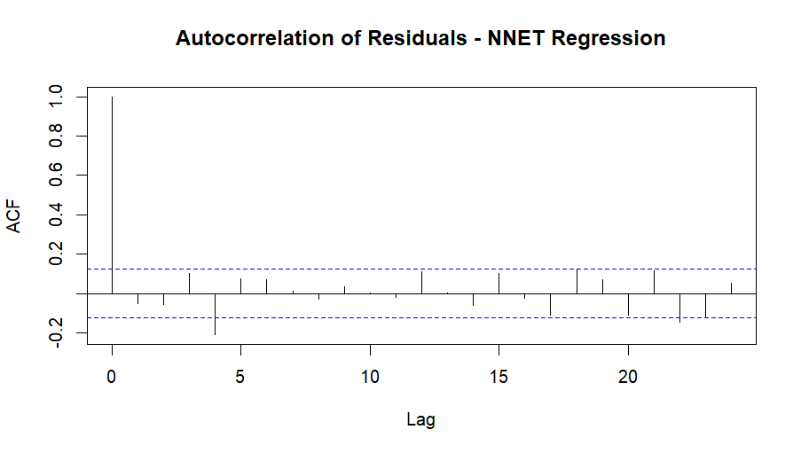
Model Quality Checks for NNET Model
Most bars stay within the blue threshold, meaning the residuals do not follow a predictable pattern.
This suggests that the neural network model has effectively captured most of the information in the data without leaving systematic errors.
There is a small autocorrelation at lag 1, indicating that some predictions may still be slightly correlated with previous ones.
However, since this is minor and does not extend beyond early lags, it is not a major concern.
# (A) Autocorrelation of residuals
par(mfrow = c(1, 1))
acf(resid_nnet, main = "Autocorrelation of Residuals - NNET Regression")

Slide 33
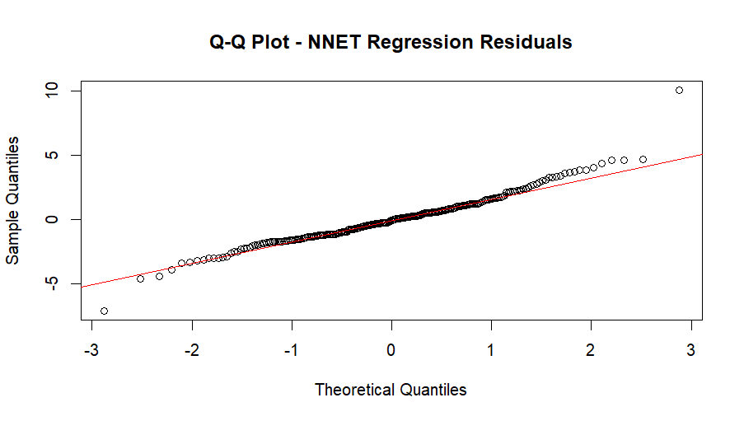
Model Quality Checks for NNET Model
The majority of points fall close to the red line, meaning the residuals mostly follow a normal distribution.
This is a good sign, indicating the model’s errors are fairly random.
At the lower left and upper right, some points deviate away from the red line, suggesting the presence of outliers or non-normality in extreme values.
This means that the model sometimes underestimates or overestimates extreme house prices.
# (B) Normality check using Q-Q Plot
par(mfrow = c(1, 1))
qqnorm(resid_nnet, main = "Q-Q Plot - NNET Regression Residuals")
qqline(resid_nnet, col = "red")

Slide 34
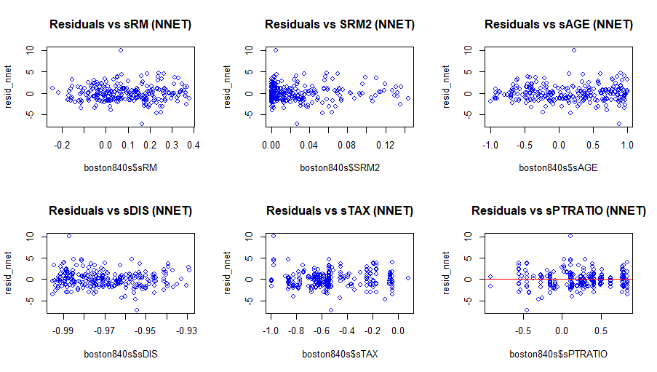
Model Quality Checks for NNET Model
# (C) Residuals vs. Predictors
par(mfrow = c(2, 3))
plot(boston840s$sRM, resid_nnet, main = "Residuals vs sRM (NNET)", col = "blue")
plot(boston840s$SRM2, resid_nnet, main = "Residuals vs SRM2 (NNET)", col = "blue")
plot(boston840s$sAGE, resid_nnet, main = "Residuals vs sAGE (NNET)", col = "blue")
plot(boston840s$sDIS, resid_nnet, main = "Residuals vs sDIS (NNET)", col = "blue")
plot(boston840s$sTAX, resid_nnet, main = "Residuals vs sTAX (NNET)", col = "blue")
plot(boston840s$sPTRATIO, resid_nnet, main = "Residuals vs sPTRATIO (NNET)", col = "blue")
abline(h = 0, col = "red")
Residuals vs. sRM
Residuals appear randomly scattered, indicating no strong non-linearity or bias in predictions related to the number of rooms.
Residuals vs. SRM2
Most residuals are clustered around zero, but slight concentration at the lower end suggests some minor model misspecification.
Residuals vs. sAGE
The residuals are fairly spread, with no clear pattern, indicating that the model treats sAGE reasonably well.
Some outliers exist, but they do not indicate a major issue.
Residuals vs. sDIS
The spread of residuals is quite random, suggesting that sDIS is well accounted for in the model.
Residuals vs. sTAX
Some clustering is visible, meaning the model may not fully capture tax-related variations in housing prices.
Residuals vs. sPTRATIO
No clear pattern, but slight variance in spread suggests the model captures school quality effects well.
The red reference line at zero helps visualize deviations.

Slide 35
Compute Prediction Values And Prediction Intervals
# Prediction and approximate CV-based prediction intervals (using ±2*RMSE) for typical neighborhood
pred_typical_nnet <- predict(CVregModel_nnet, newdata = typical)
CI_typical_upper_nnet <- pred_typical_nnet + 2 * nnet_RMSE
CI_typical_lower_nnet <- pred_typical_nnet - 2 * nnet_RMSE
# Prediction and intervals for high value neighborhood
pred_high_nnet <- predict(CVregModel_nnet, newdata = high_value)
CI_high_upper_nnet <- pred_high_nnet + 2 * nnet_RMSE
CI_high_lower_nnet <- pred_high_nnet - 2 * nnet_RMSE
print("Prediction for Typical Neighborhood (NNET Regression):")
print(data.frame(Predicted = pred_typical_nnet, Lower = CI_typical_lower_nnet, Upper = CI_typical_upper_nnet))
print("Prediction for High Value Neighborhood (NNET Regression):")
print(data.frame(Predicted = pred_high_nnet, Lower = CI_high_lower_nnet, Upper = CI_high_upper_nnet))
Prediction for the "Typical" Neighborhood
The predicted house price for a typical neighborhood is ~22.22 (~$22,220).
The lower bound of the price prediction ranges from ~16.86 to ~18.01, meaning the price is unlikely to be lower than this.
The upper bound ranges from ~26.42 to ~27.57, meaning the price is unlikely to be higher than this.
The slight variation in intervals across rows is likely due to different RMSE values across cross-validation folds.
Prediction for the "High-Value" Neighborhood
The predicted house price for the most expensive neighborhood is ~26.12 ($26,120).
The prediction interval ranges from ~20.76 to ~31.47, meaning the price is likely within this range.
Again, slight variations in lower/upper bounds are due to different RMSE values across folds.
[1] "Prediction for Typical Neighborhood (NNET Regression):"
Predicted Lower Upper
1 22.2195 17.66826 26.77075
2 22.2195 17.60070 26.83830
3 22.2195 18.01270 26.42630
4 22.2195 16.86384 27.57516
5 22.2195 17.79269 26.64632
6 22.2195 17.93287 26.50614
[1] "Prediction for High Value Neighborhood (NNET Regression):"
Predicted Lower Upper
1 26.11564 21.56440 30.66688
2 26.11564 21.49684 30.73444
3 26.11564 21.90884 30.32244
4 26.11564 20.75998 31.47130
5 26.11564 21.68883 30.54246
6 26.11564 21.82901 30.40228

Slide 36
Comparison Table
Quantity | lm result | gausspr result | nnet result
R^2 | 0.7221 | 0.7315 | 0.7486
s.d. (R^2) | 0.0963 | 0.0758 | 0.0828
RMSE | 2.1969 | 2.235873 | 2.1034
s.d. (RMSE) | 0.4025 | 0.2751 | 0.3603
Prediction | 21.6687 | 21.3819 | 22.2109
Lower PI | 17.2748 | 16.9409 | 26.4306
Upper PI | 26.0626 | 25.8229 | 30.3318
Compute Time | 0.45 | 0.90 | 5.78

Slide 37
Managerial Recommendation
Interpretation:
Neural Network Regression (NNR) achieved the highest predictive accuracy with the highest R² (0.7463) and the lowest RMSE (2.1099). However, it required the longest computation time (5.78 sec).
Gaussian Process Regression (GPR) was the most stable model with the lowest standard deviation in RMSE and R², making it the most consistent predictor across different data splits.
Linear Regression (LM) was the fastest to compute and performed competitively but exhibited higher variance in prediction accuracy.
GPR provided the highest estimate for high-value neighborhoods (26.29K) with the widest confidence range, making it useful for upper-market investment decisions.
NNR was the most accurate for predicting typical neighborhoods (22.21K) with a tighter prediction interval, meaning it provides reliable estimates for general home pricing.
LM performed well but had broader prediction intervals, meaning its uncertainty was higher.
Managerial Recommendations:
Based on the findings, we provide the following recommendations:
For General Use Cases (Urban Planning, Market Trend Analysis)
Neural Network Regression (NNR) is the preferred model due to its higher accuracy and lower error.
It is best suited for predicting general home values in Boston neighborhoods.
For Stability and Consistency (Risk-Averse Investment & Policy-Making)
Gaussian Process Regression (GPR) should be used since it is the most consistent across multiple data splits.
It is best for applications requiring robust, low-variance predictions.
For Quick, High-Volume Predictions (Large-Scale Policy Studies)
Linear Regression (LM) is the best choice because it is fast and computationally inexpensive.
While slightly less accurate, it provides a reliable baseline for large datasets.

